Slide 1




GitHub Copilot for Developers
Tim Warner
Principal Author, Pluralsight
timw.info | azureopenai.blog

Slide 2
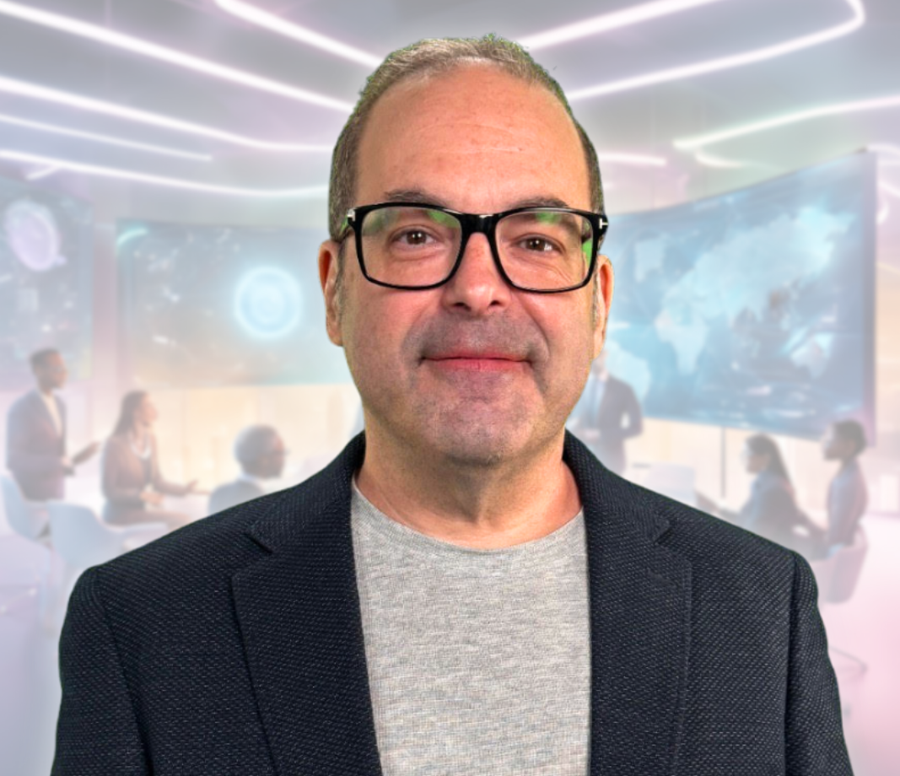
Tim Warner
Based in Nashville, TN, US
28-year Microsoft Certified Trainer (MCT)
8-year Microsoft MVP in Azure AI
Contact: TechTrainerTim.com

Slide 3
Course Flow (Central time)
09:00 AM - Start – Segment 1 [Foundations & Core Workflow]
10:00 AM - 10 min break – Segment 2 [Chat Power Features]
11:00 AM - 10 min break – Segment 3 [Agentic Features]
12:00 PM - 10 min break – Segment 4 [Enterprise Features]
01:00 PM - Finish

Slide 4
Session Materials
timw.info/copilot-dev

Slide 5
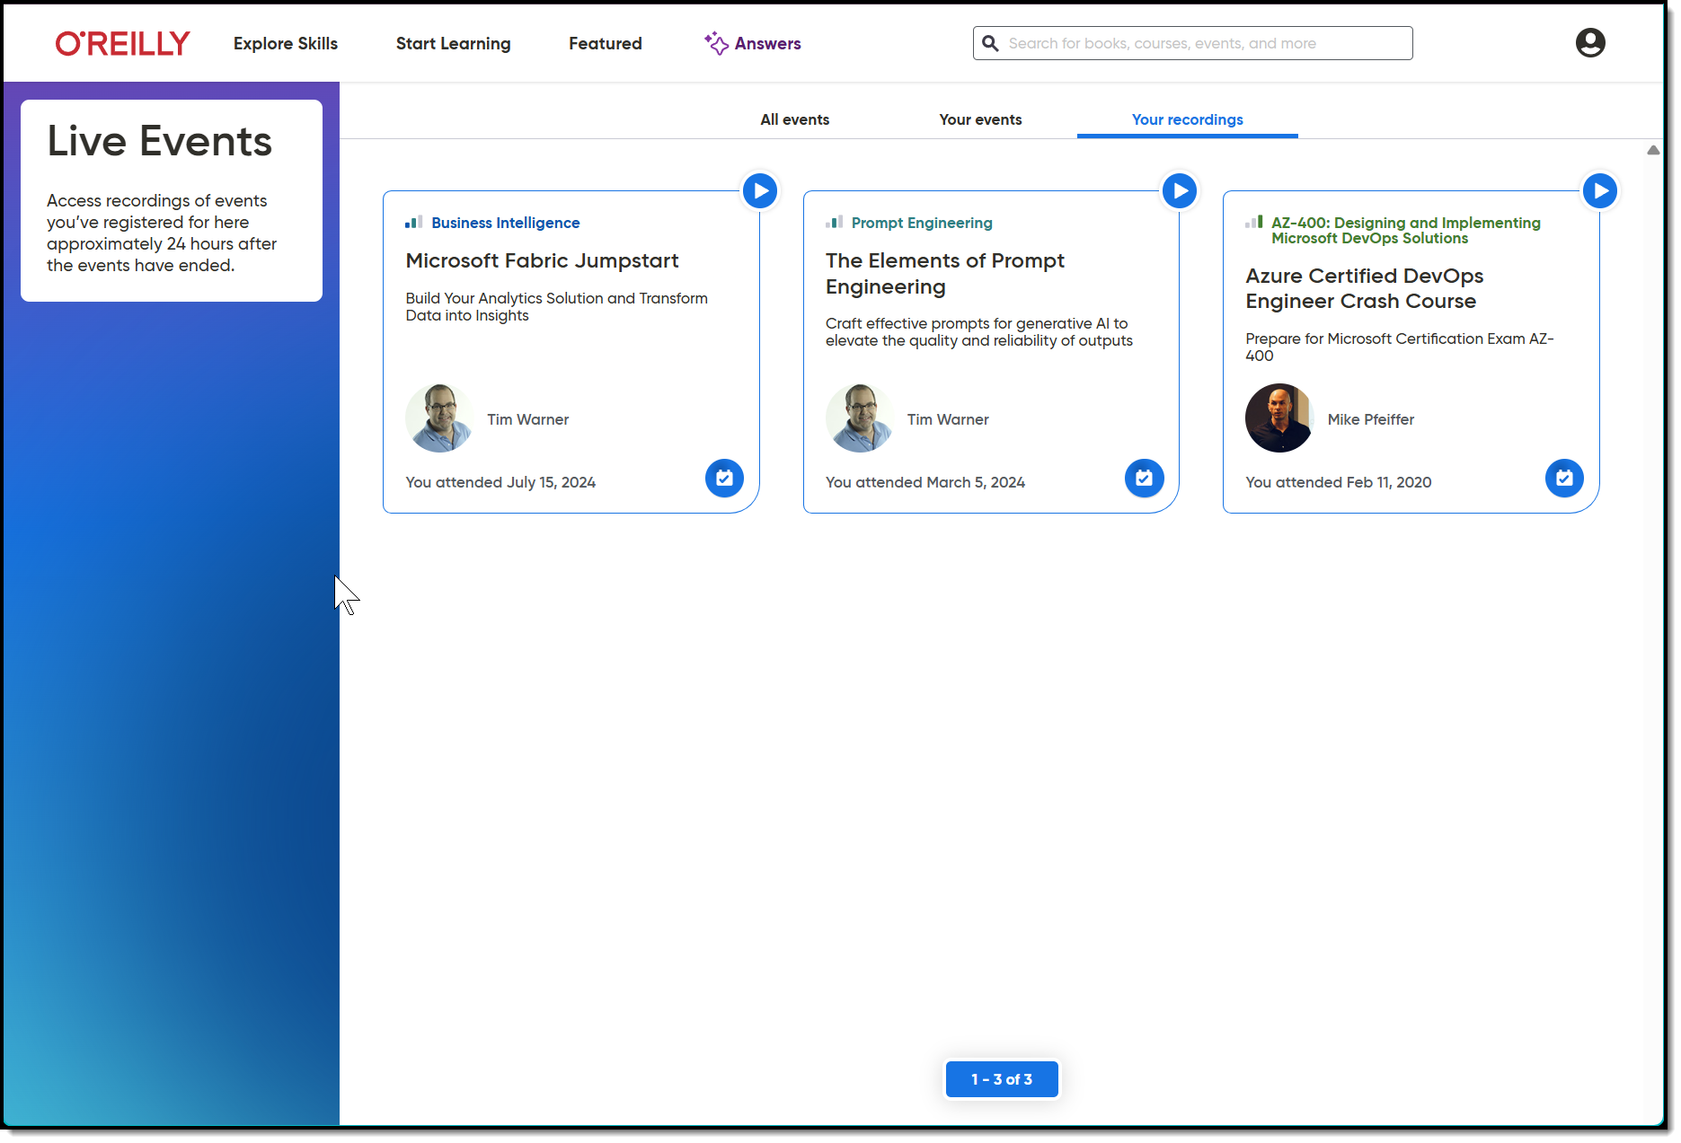
Session Recording + Badge

Slide 6
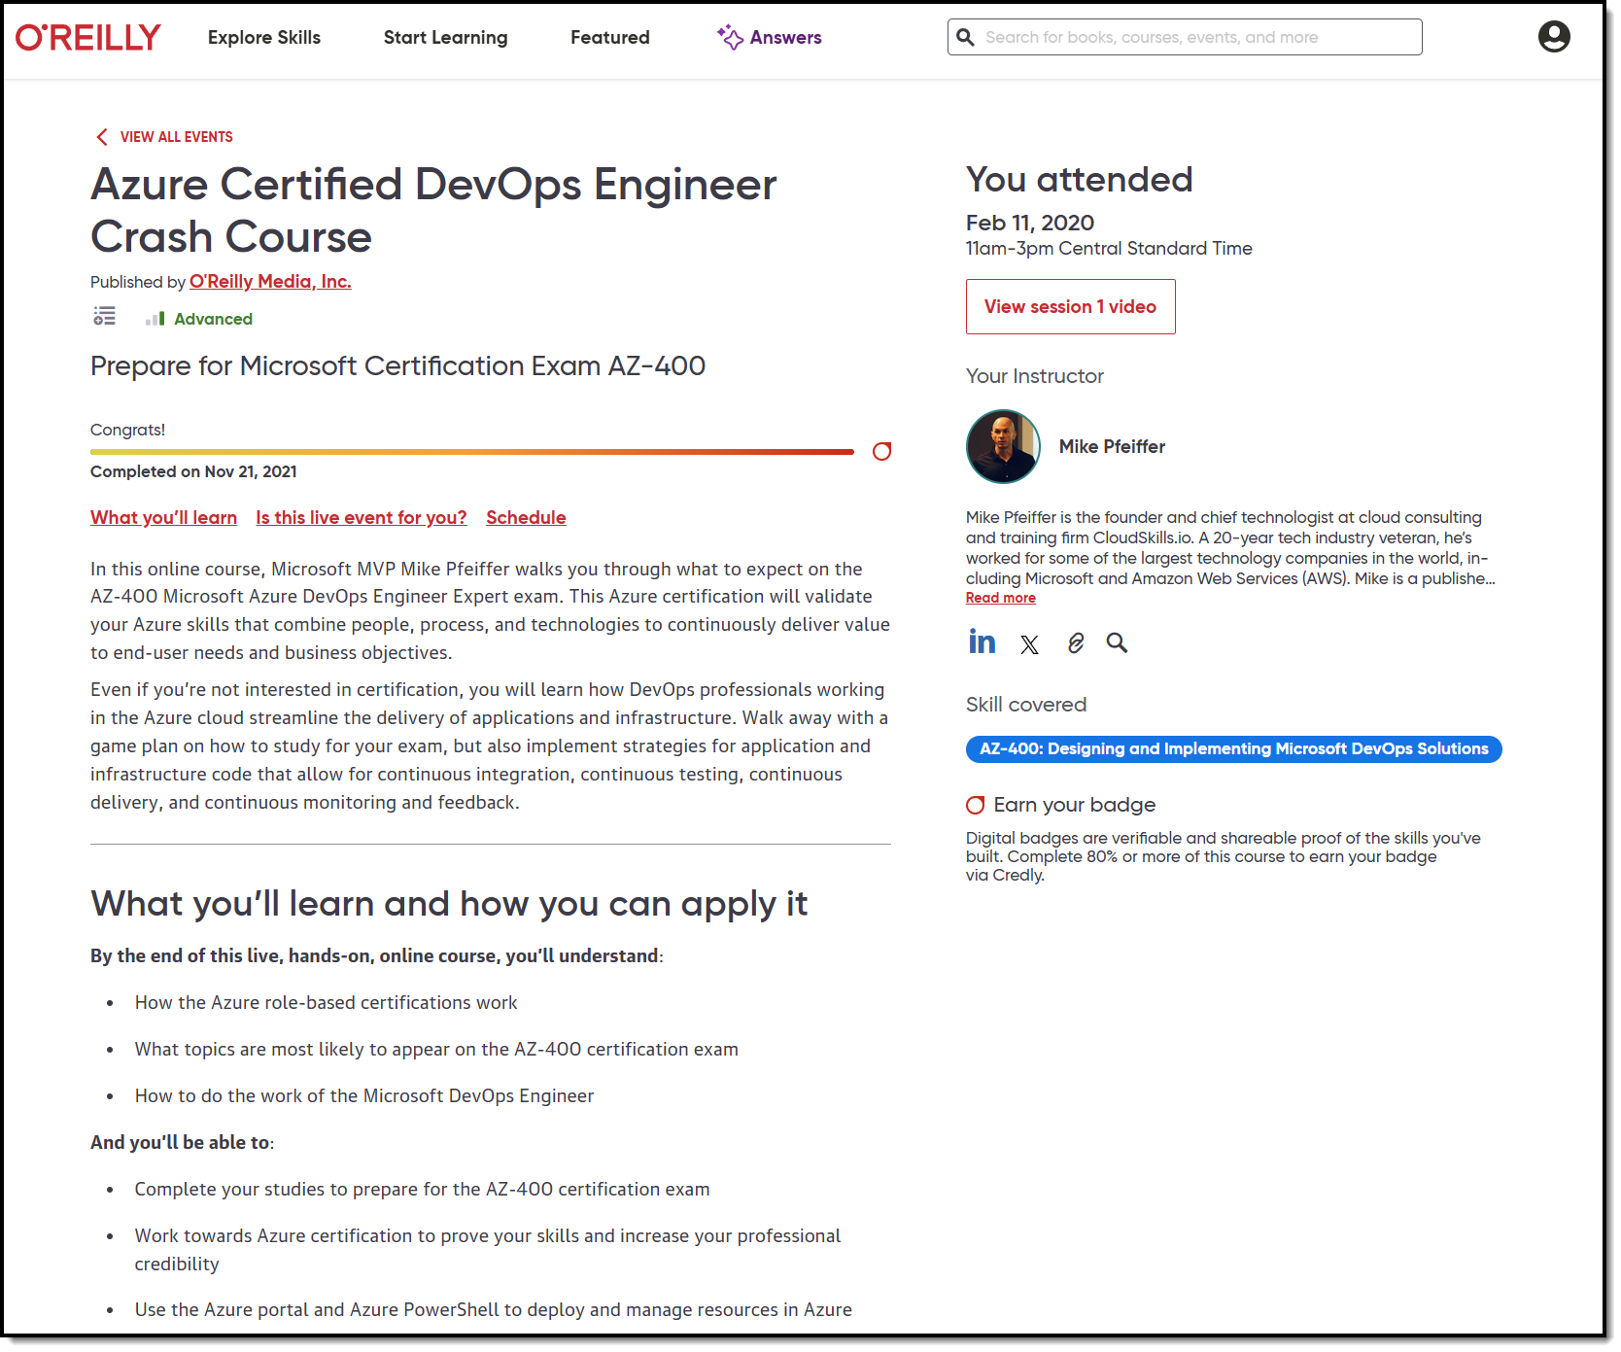
Session Recording + Badge

Slide 7
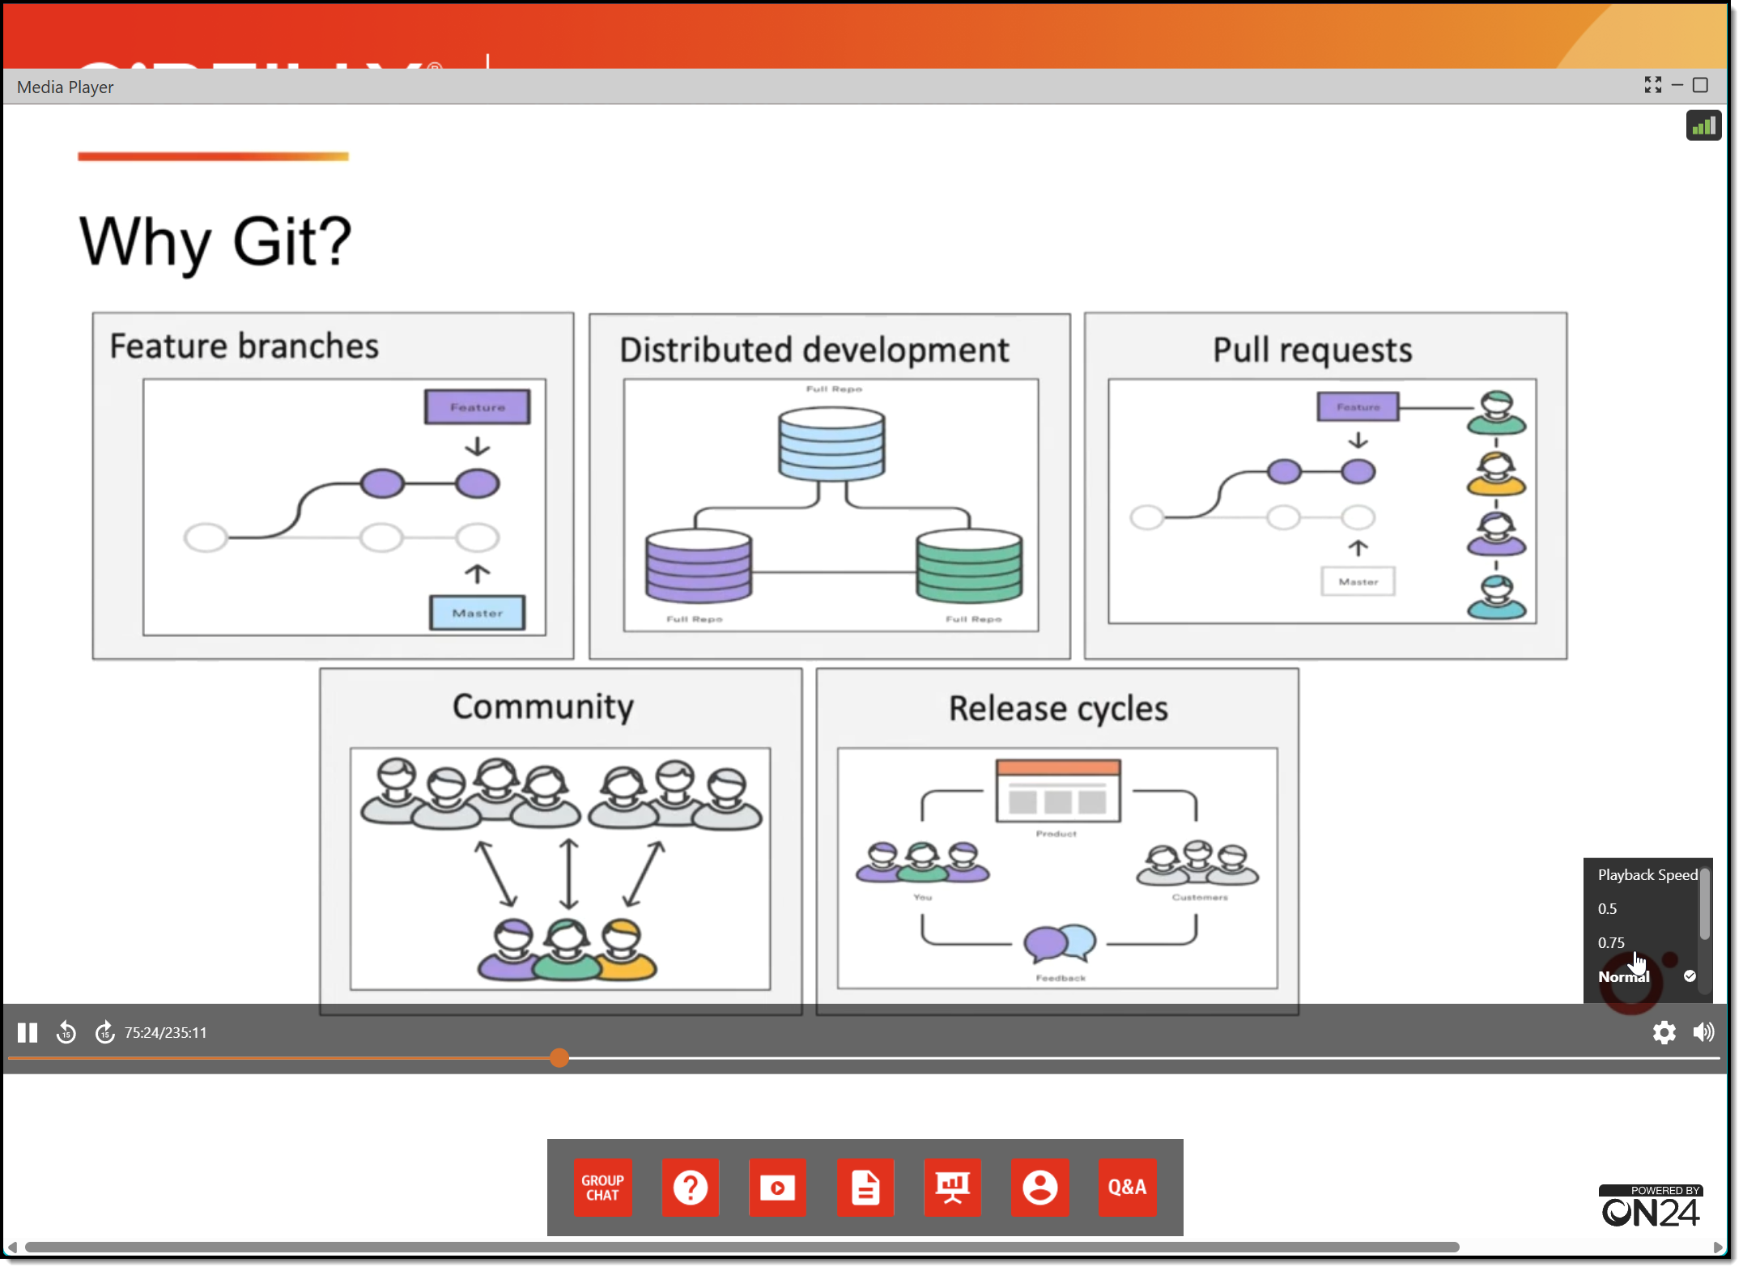
Session Recording + Badge

Slide 8
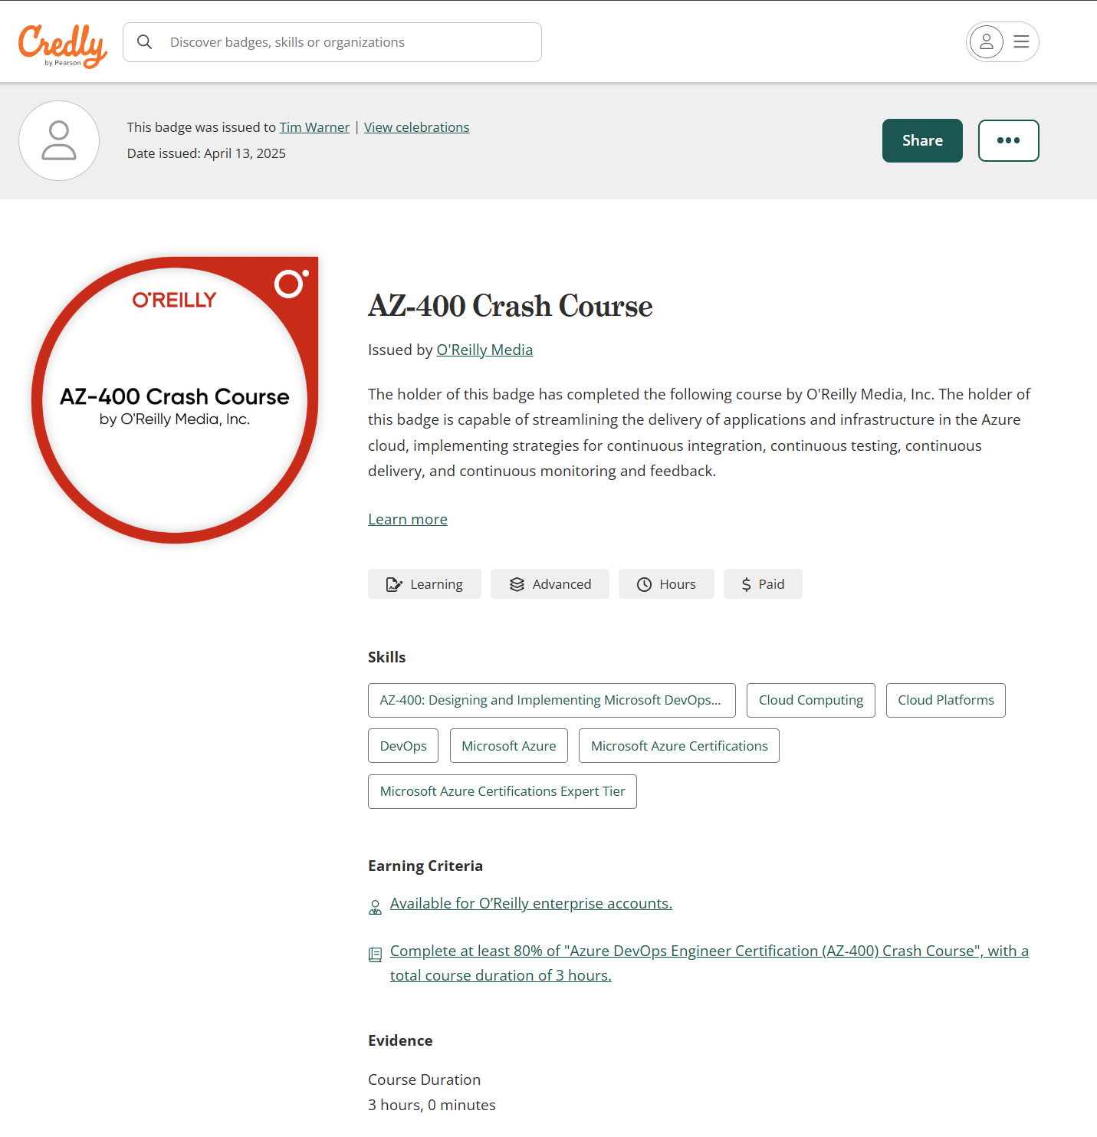
Session Recording + Badge

Slide 9
Questions?
Please add questions to the Q&A window so I don’t miss them
Only O’Reilly folks and I can read them
Your name shows up as initials with no company name

Slide 10



Keeping an LLM on task be like…

Slide 11
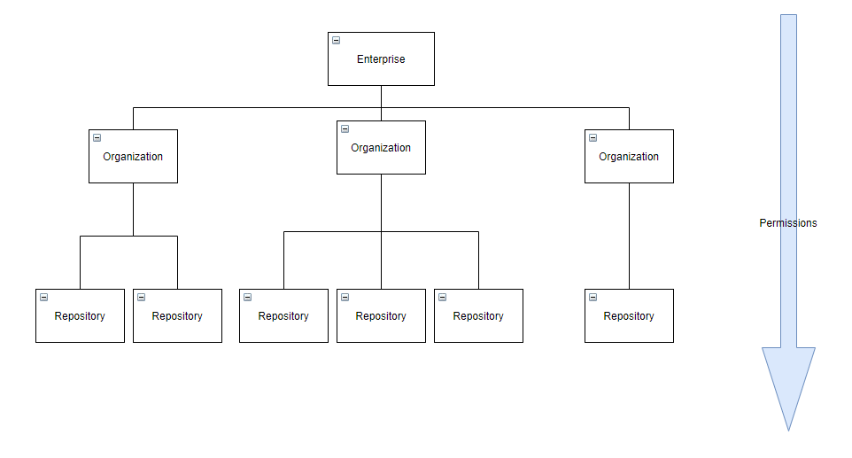
GitHub Enterprise Cloud (GHEC)
Reference: https://github.com/dduzgun-security/github-enterprise-cloud-configuration

Slide 12
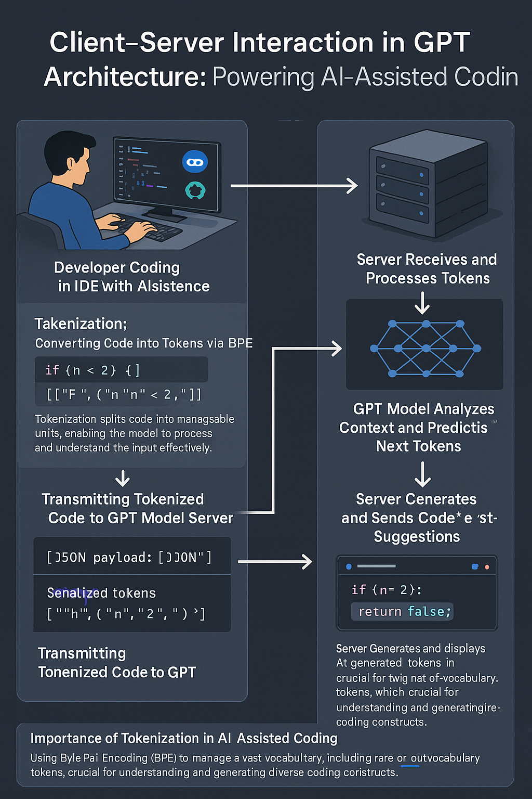
GPT Basic Architecture
OpenAI GPT 4o Image Generation
Multimodal generative AI
Two ways to improve model:
Fine tuning
Retrieval Augmented Generation (RAG)

Slide 13
Custom Instructions Scopes
Repo: .github/copilot-instructions.md
Workspace: .github/instructions/*.instructions.md
YAML directive
---
applyTo: "src/**/*.js"
---
Org: In GitHub web UI
MCP: Agent mode gear icon

Slide 14

Neural Network
go.techtrainertim.com/cloud

Slide 15

Context Length

Slide 16
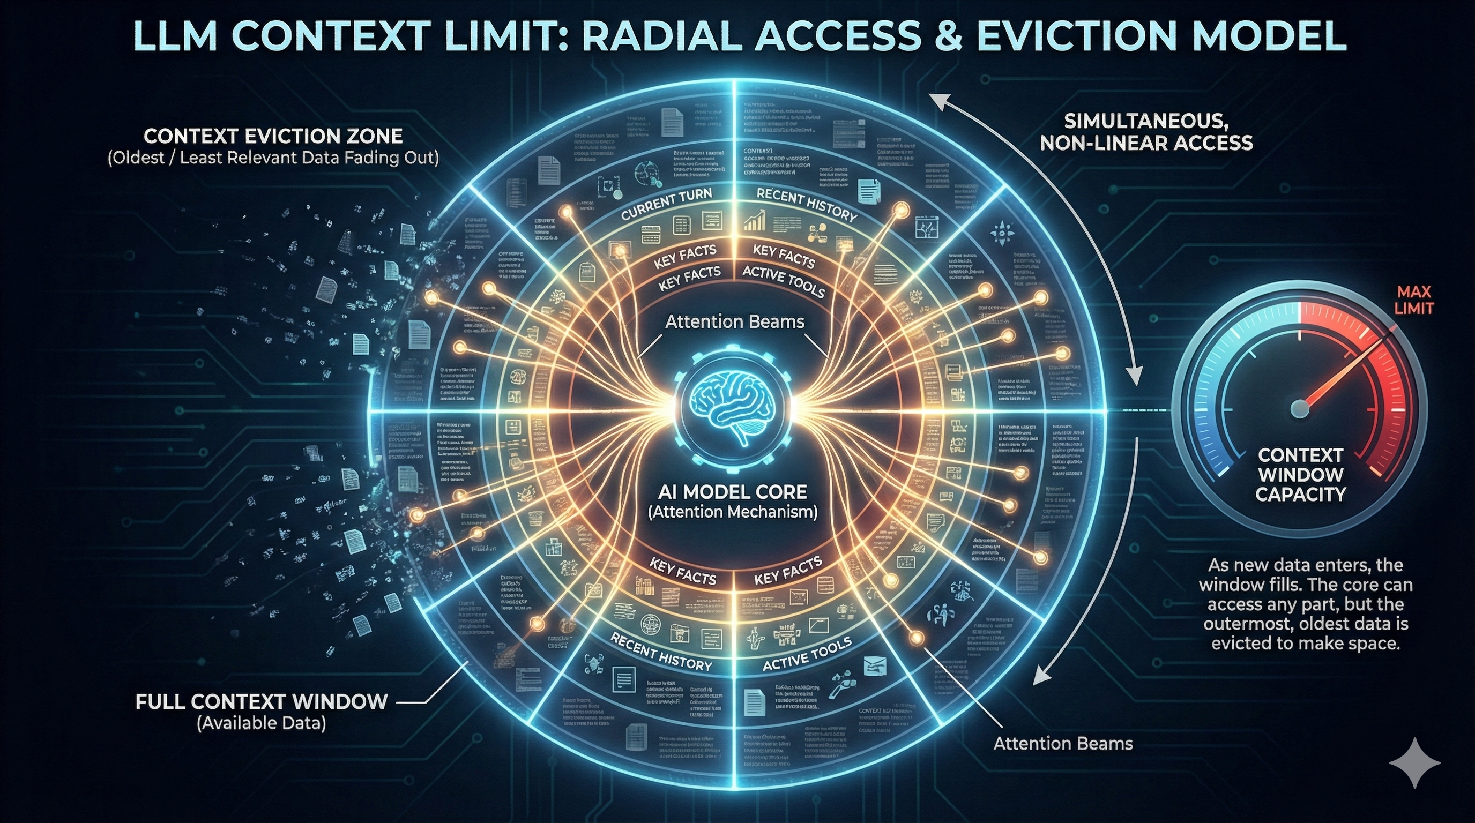

Slide 17
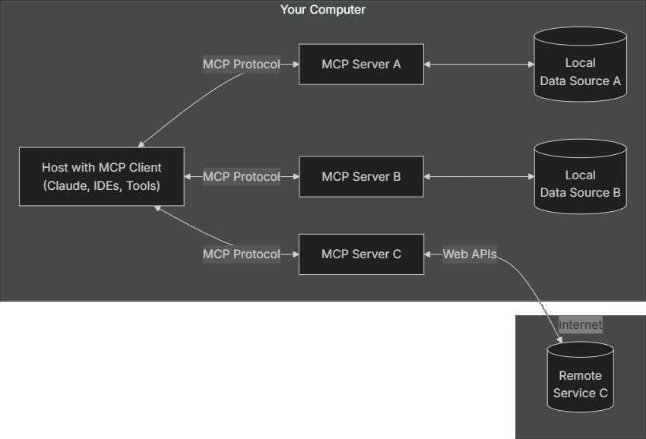
Model Context Protocol (MCP) by Anthropic
modelcontextprotocol.io

Slide 18
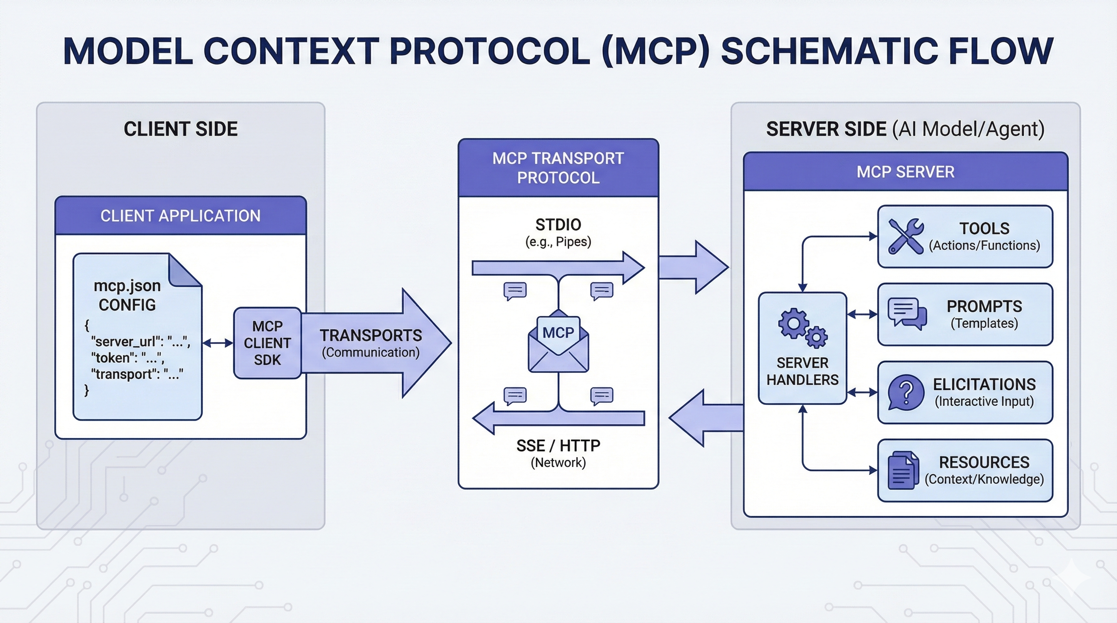

Slide 19
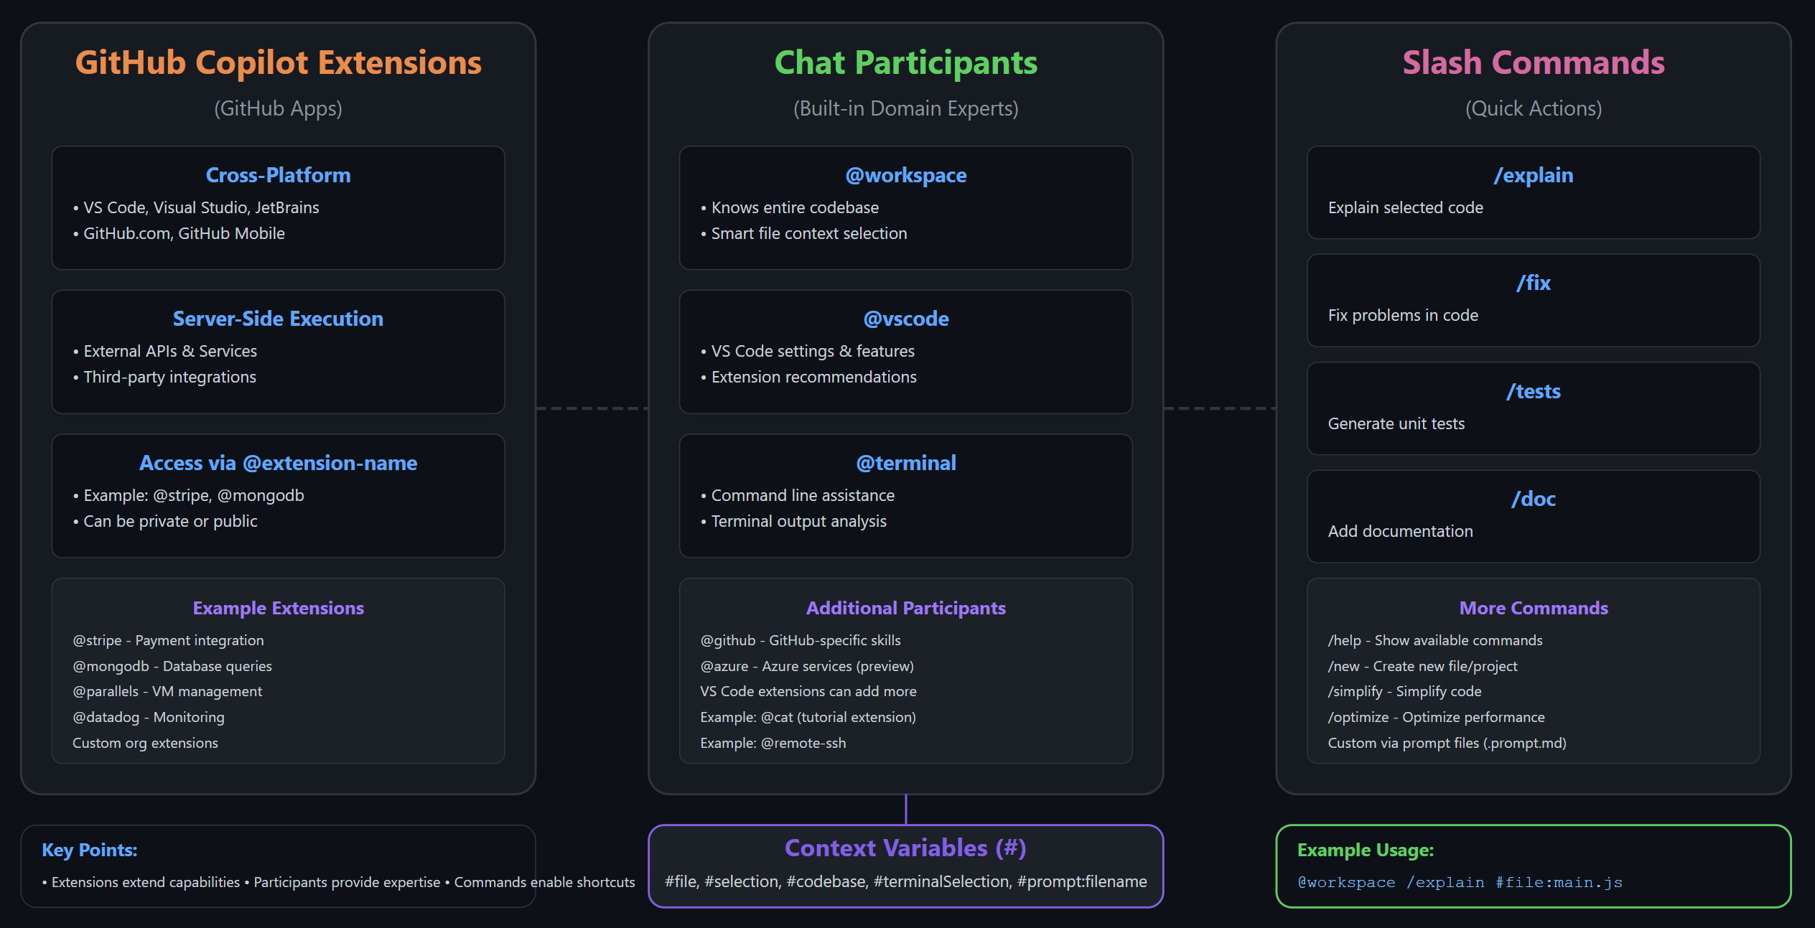
Extending GitHub Copilot

Slide 20
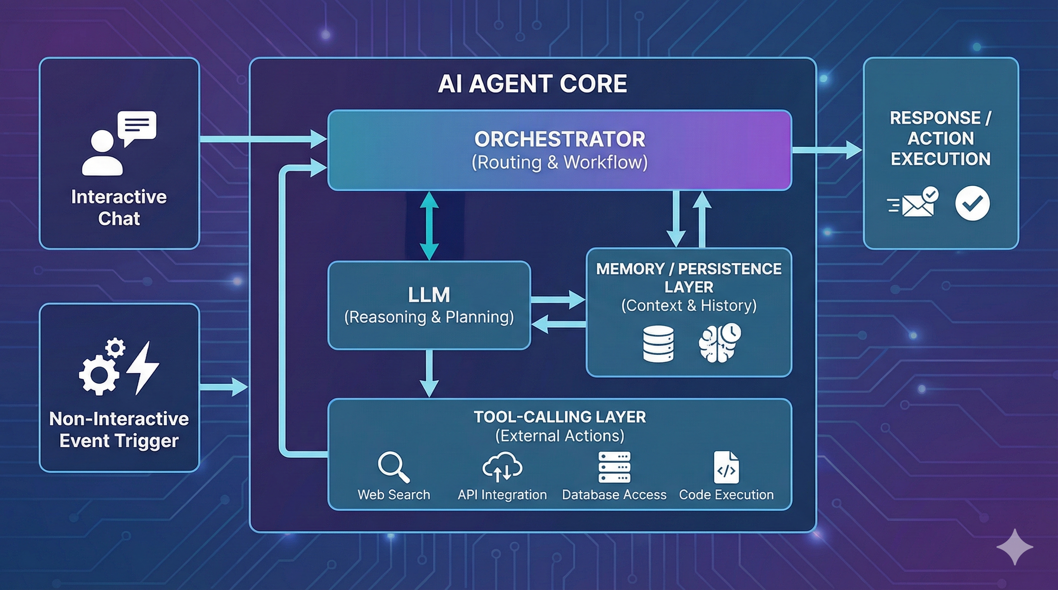

Slide 21
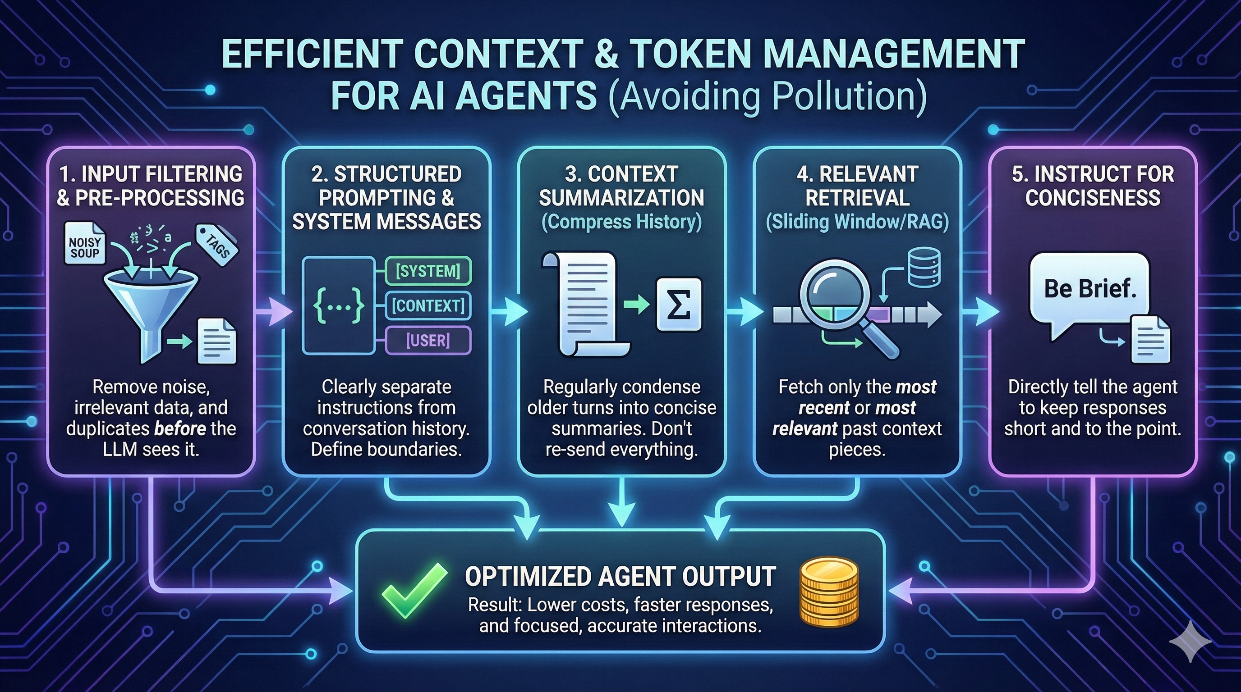

Slide 22
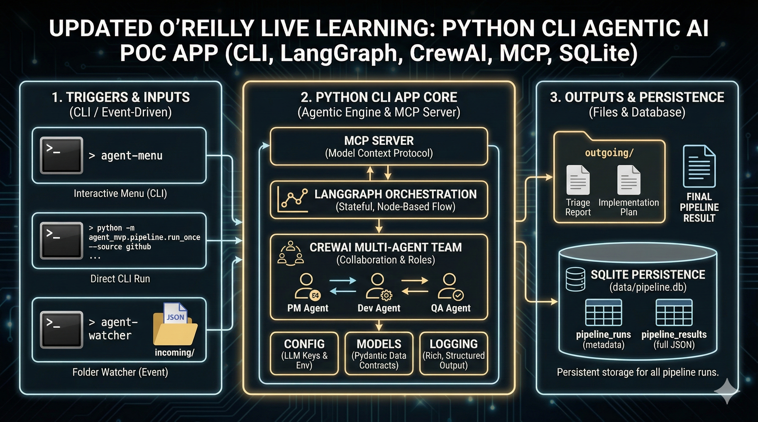

Slide 23
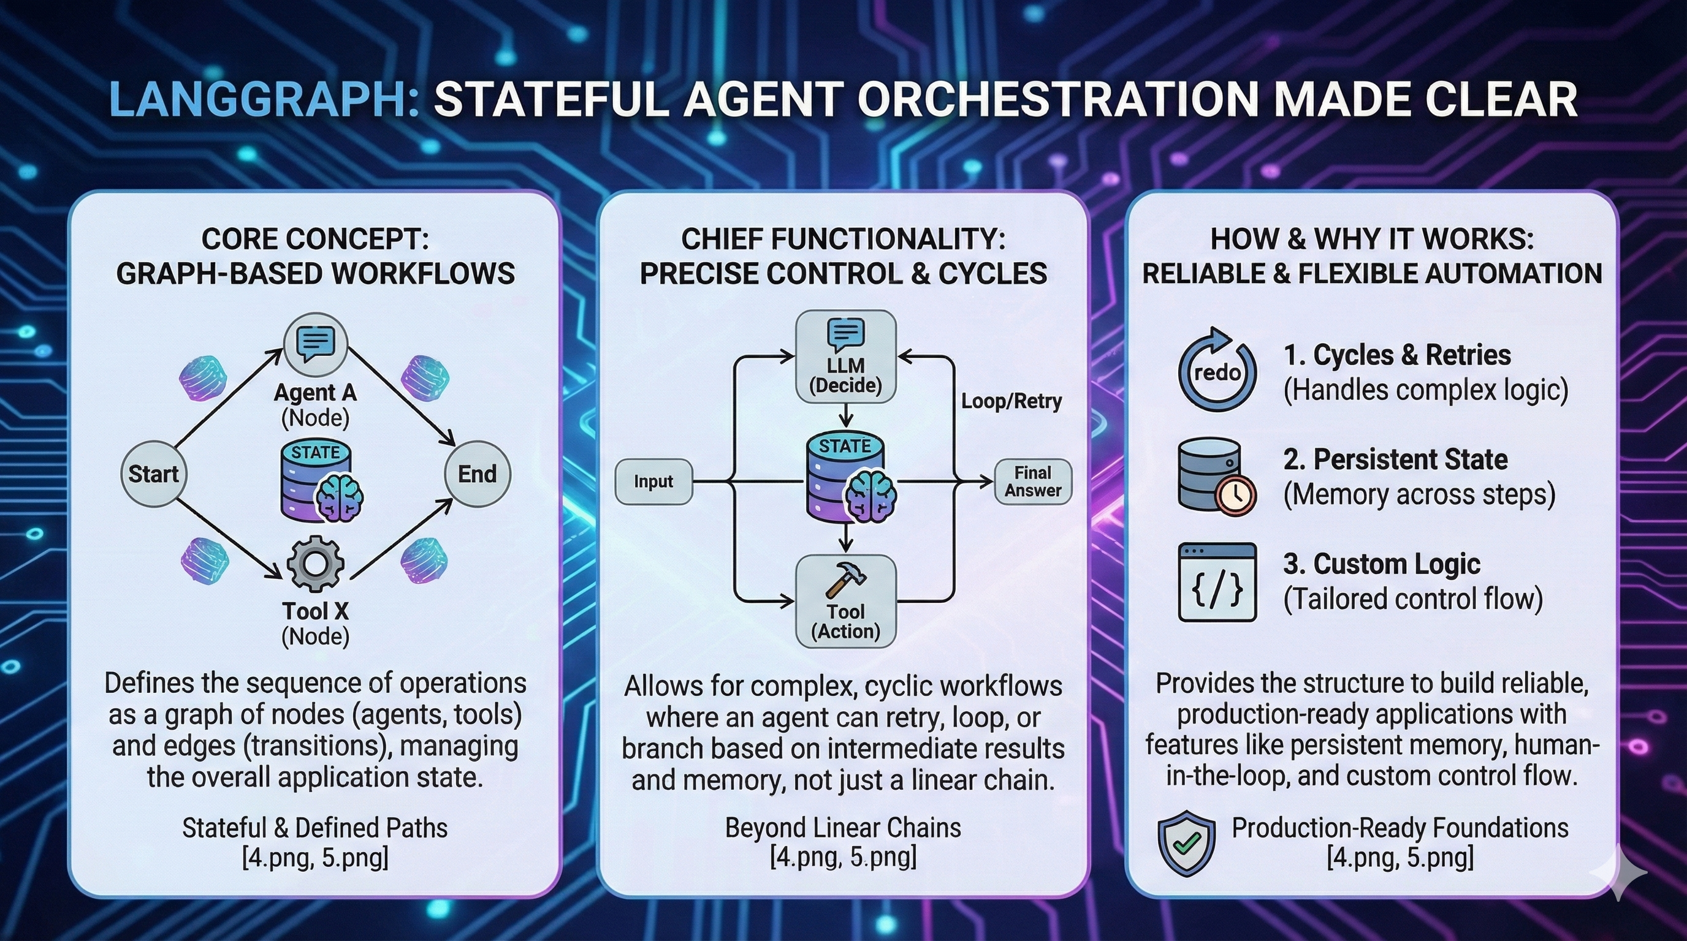

Slide 24
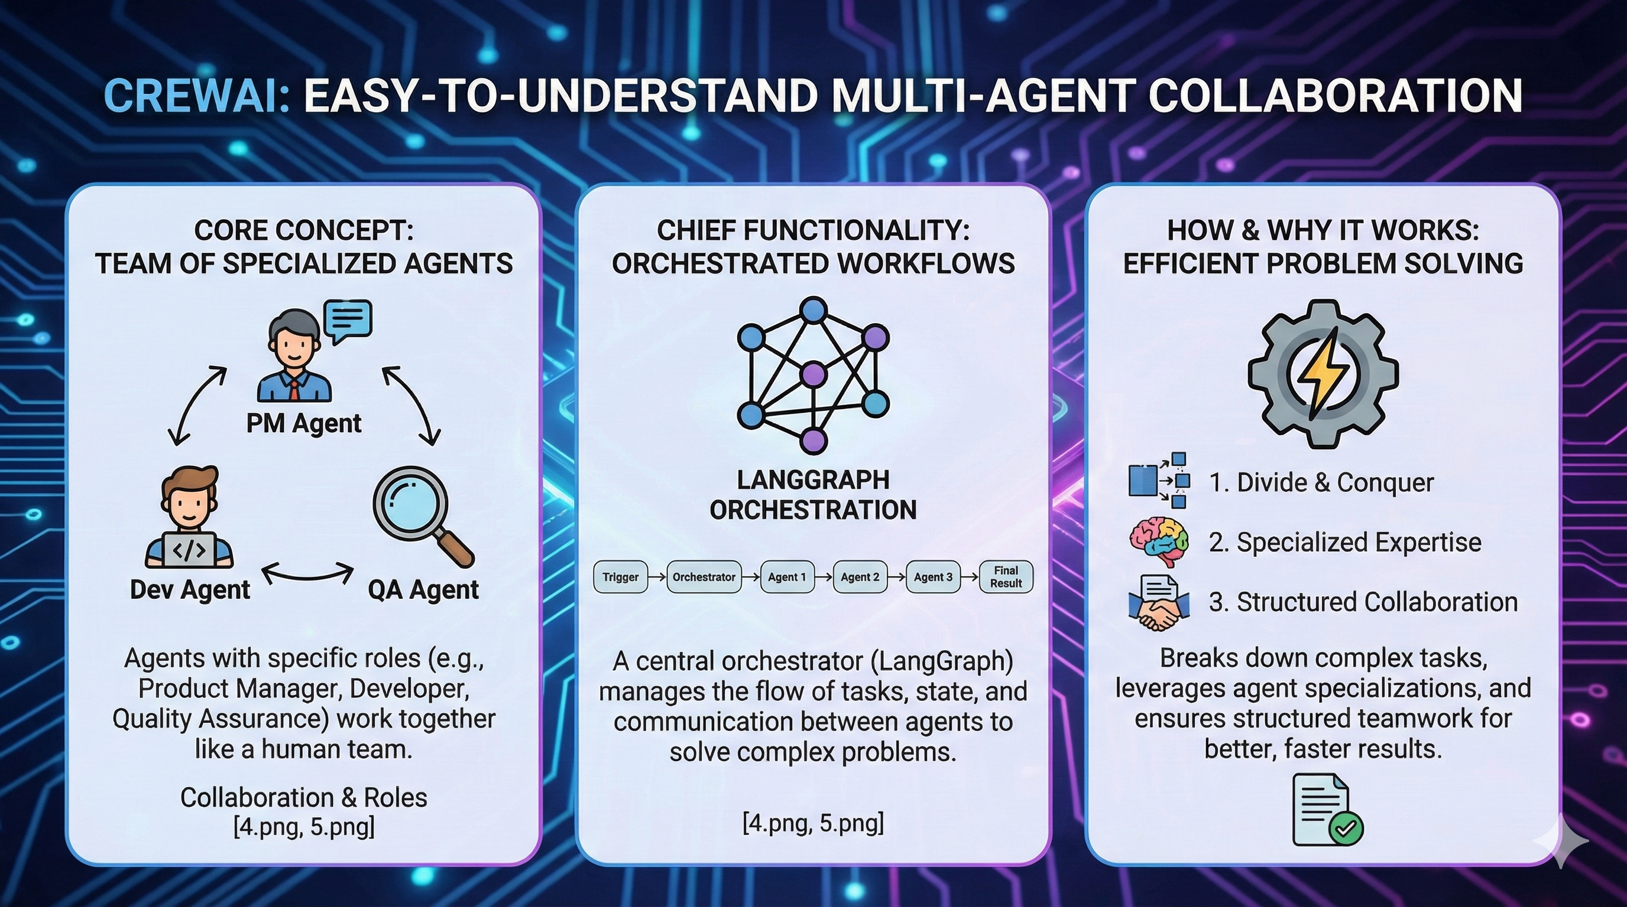

Slide 25
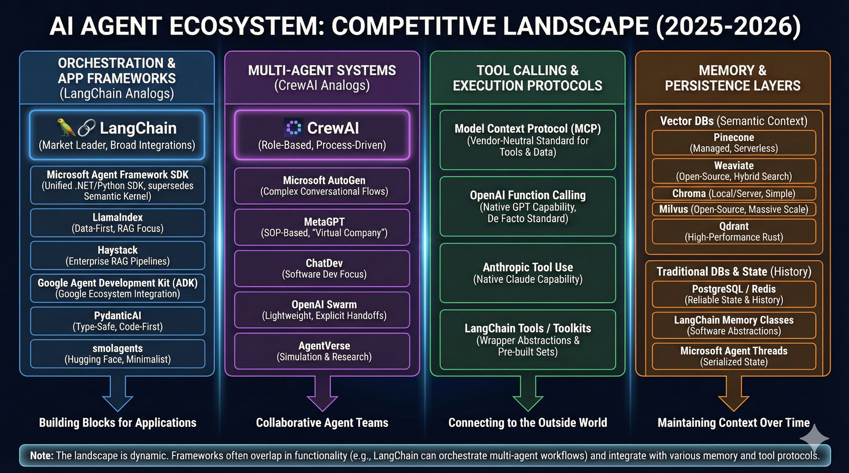

Slide 26
Thank you!
Course materials: timw.info/copilot-dev
Contact: TechTrainerTim.com

